Slide 1
Creating a SWYC Screening Plan, Part 1/5 What is a screening plan, and why do you need one?
Ellen C. Perrin, MD
R. Christopher Sheldrick, PhD
Kate Mattern, BA

Slide 2
Parts of this Powerpoint series
5 parts in this Powerpoint series:
Part 1: What is a screening plan, and why do you need one?
Part 2: Defining your population
Part 3: Building your infrastructure
Part 4: Assign your roles and train your staff
Part 5: Plan out your post-screening actions
All available at www.theswyc.org
Notes:
More and more state Medicaid agencies and commercial insurance companies, as well as Bright Futures and other professional policies, are recommending systematic developmental screening. Like many innovations in practice settings, this is easier said than done. We have put together some tips to help you get an effective screening program set up in your practice.
There are 5 parts in this powerpoint series. This first presentation will focus on what a screening plan is and why you might want to create one. Part 2 talks about defining your screening population. Part 3 talks about building your screening infrastructure. Part 4 covers assigning roles and training staff, and part 5 focuses on planning out how you will follow up on screening results. All the other presentations in this series are available on our website, www.theswyc.org

Slide 3
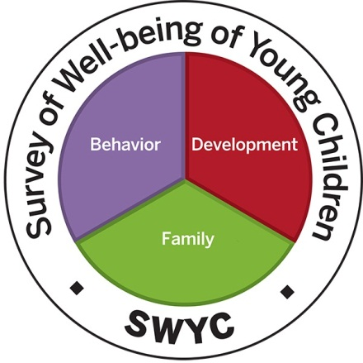
What is a screening plan?
A screening plan = practical logistics
Considers every step, from printing off forms to interpreting screens
Notes:
A screening plan is a practical guide to how screening will work at your practice- which children will be screened, how staff will be trained and responsibilities divided, and what you will do with the results. A good screening plan charts the entire screening process from start to finish, drilling down to the nitty-gritty details of how screening will look on the ground.
Thinking through a screening plan at the outset of your use of the SWYC will prevent common pitfalls that can undercut your success- confusion over why you are screening and what procedures to follow, muddied ideas about who is responsible for what parts of the process, and misinformation about the appropriate way to follow through on a positive screen.

Slide 4
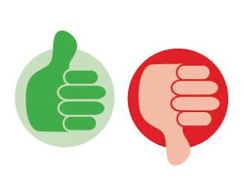
Helps ensure everyone is on board
“How will this affect our workload?”
“ Why is it worth doing?”
“Will this be good for our patients?”
“Who am I supposed to go to if I have problems with our new screening process?”
“What do I do when a child screens positive- do we really have the resources to help?”
Notes:
A screening plan is critical to ensuring that you have buy-in from everyone on the staff. For some people, starting to use the SWYC may feel like an easy no-brainer. For others, it might feel dauntingly burdensome. Reasonable people may disagree about what screening instrument is best for your practice and how the costs of implementing a screening program, balance with the benefits.
It is important to consider up front how you will respond to common questions from staff. “How will this affect our workload? Why is this worth doing? Will this be good for our patients? If I have a problem with our new screening process, who am I supposed to address it with?”

Slide 5
Prepares you for common misconceptions and frustrations
“It feels like the SWYC is detecting way too many positives!”
“This child scored positive on the POSI, but after I talked to the parent, I don’t think the child really has Autism. Do I have to refer?”
“The SWYC asks some questions that are ‘too hard’ for even typically developing children. I’m worried this will scare parents, even if their child is fine. What am I supposed to say?”
Notes:
Having a screening plan will mean you are better prepared for common frustrations and misconceptions about the meaning of positive screens. There is a lot of advice out there that the appropriate response to a positive screen is to refer- but since screening is designed to have a low barrier, LOTS of children will screen positive and we all know that referring every positive is not feasible in most settings. It’s worth thinking through potential confusion about this sort of issue up front.
How will you answer if pediatricians in your practice are concerned that the SWYC is identifying too many children? If referring every positive score is clearly not the correct response, then what is? What if staff are concerned that the forms will make parents worry about their child’s development or behavior even if there is not really a problem?

Slide 6
Streamlines procedures
“Wait, are we screening children UP to five years old, or THROUGH five years old?”
“Who is responsible for scoring these forms? They keep getting handed to me un-scored.”
“This child is 4 and was born 6 weeks premature- am I supposed to give his parent the form for his chronological age, or his adjusted age?”
Notes:
A screening plan will also let you specify the procedures for your practice, reducing headaches down the line. It will help you think through the details that can create big frustrations- like which children are supposed to be screened, who is responsible for various tasks, and how to deal with important details like when and how to adjust a child’s age for prematurity.

Slide 7
Taking the time now will…
Make sure everyone is on-board
Encourage you to think about small but critical details
Ensure the right people are trained for the right tasks
Reduce confusion over procedures
Think through how any problems that arise will be addressed
Notes:
By taking the time to create a screening plan, you’ll ensure that your staff is on-board, critical details are addressed, people are appropriately trained, confusion is reduced, and there is a system in place to deal with problems that may arise despite your planning.
Please continue on to the other parts of this powerpoint series to learn more. You can also learn more by taking advantage of other good resources on creating a screening plan, like those on the next slide.

Slide 8
Other screening plan resources
This Powerpoint is first in a series. Find the rest of the presentations in the series at www.theswyc.org.
Children’s Hospital has created an online resource about creating a screening plan using the PEDS: http://www.childrenshospital.org/developmental-screening/how-to-implement
The ASQ provides implementation tips here: http://agesandstages.com/wp-content/uploads/2015/06/Tips-for-ASQ-in-Pediatric-Practices.pdf

Slide 9
We’d appreciate your feedback on this powerpoint!
Answer two quick satisfaction questions here: https://www.surveymonkey.com/r/XQ22CQZ
Notes:
Thanks for listening. You may wish to continue to part two of this series to learn about defining your screening population.

